Slide 1
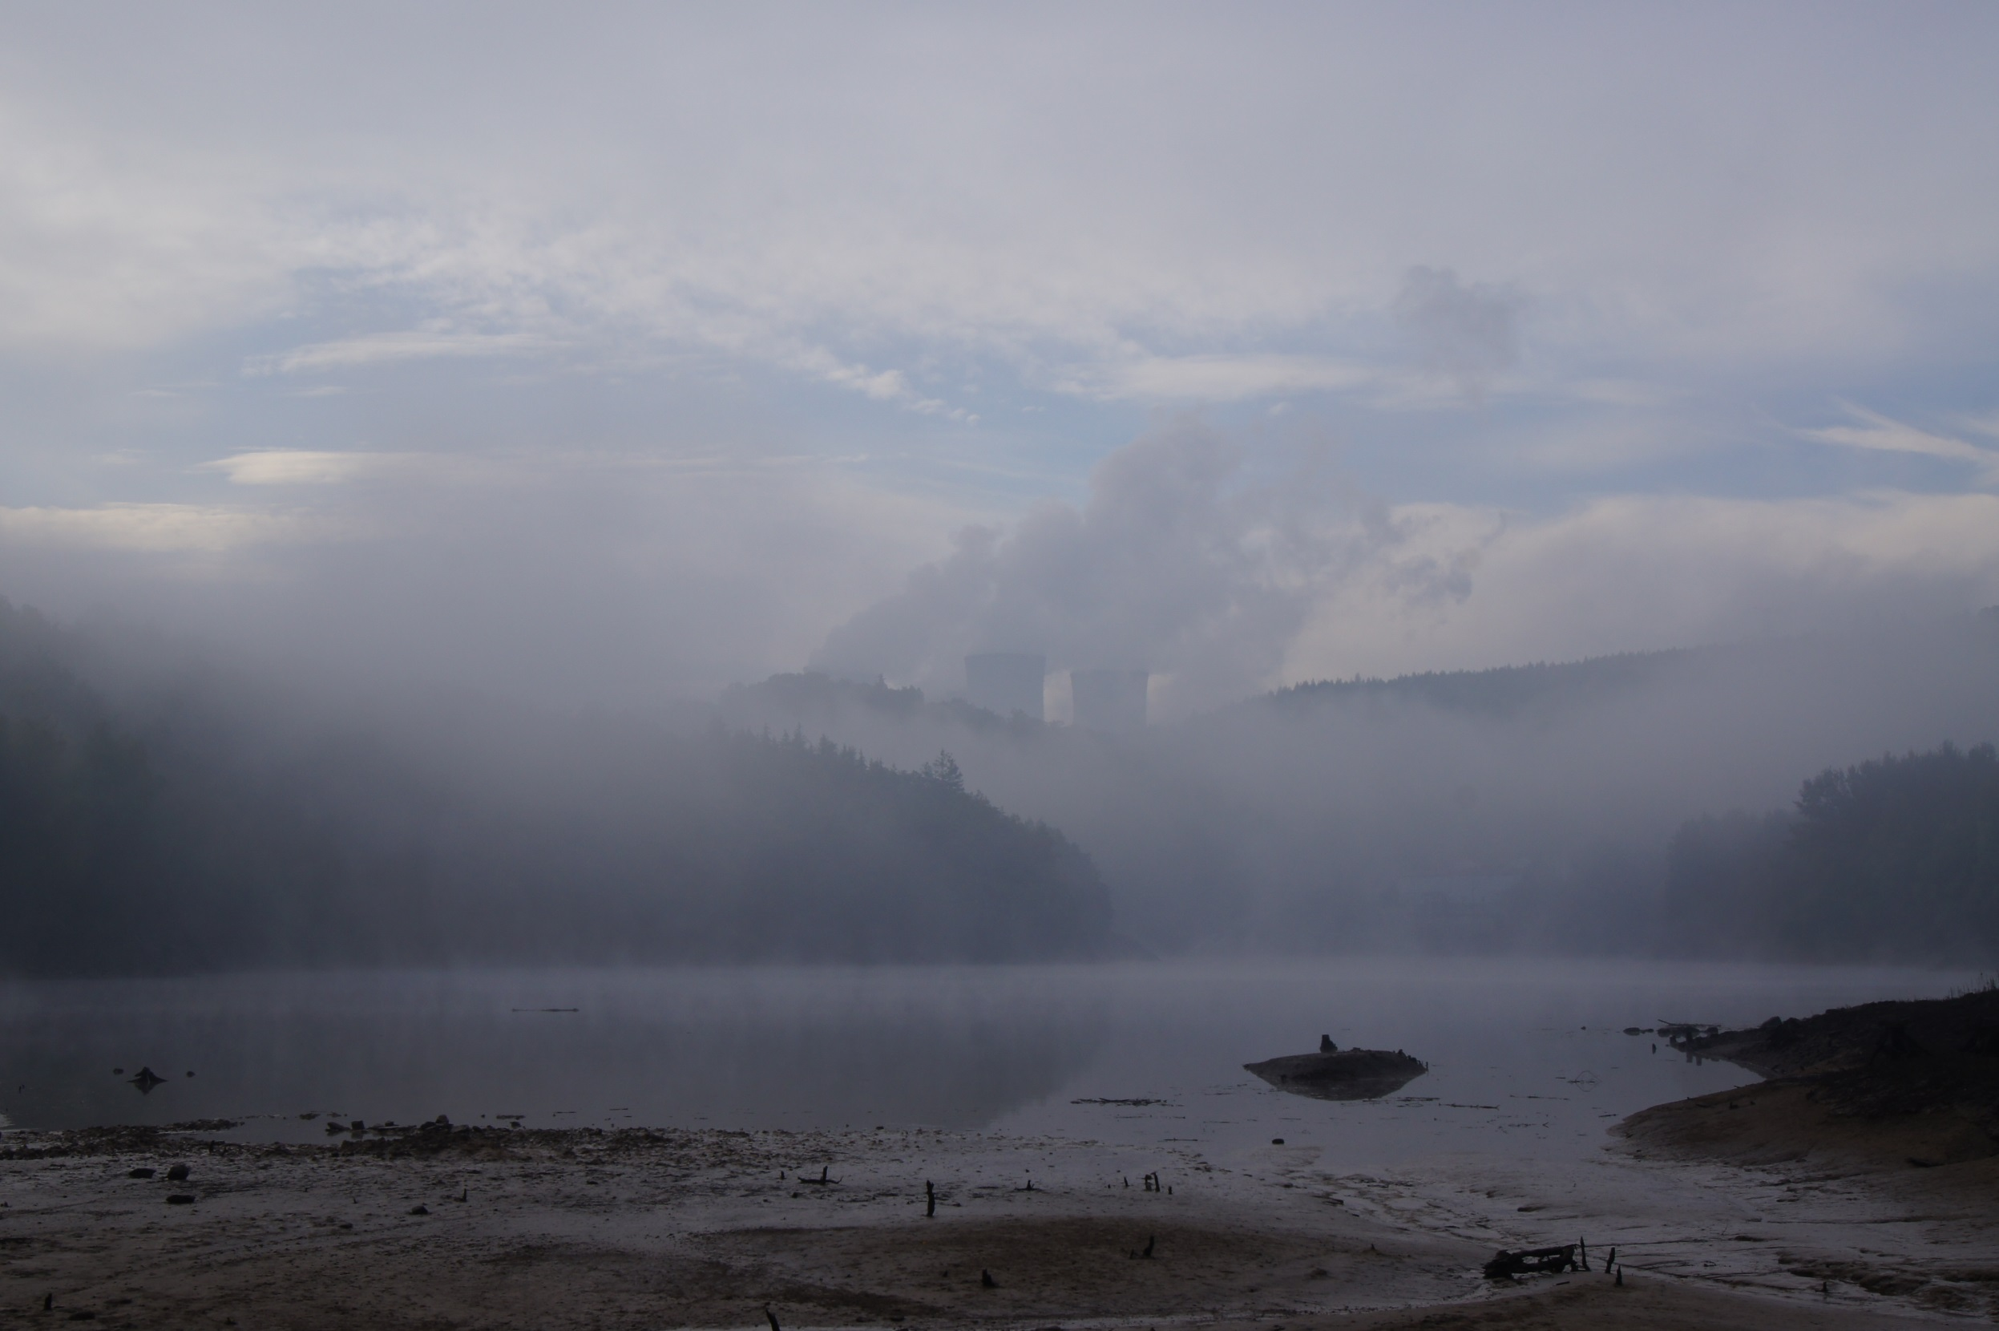
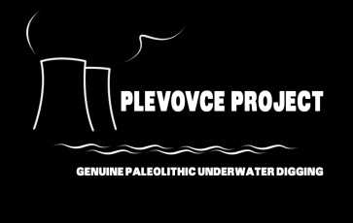
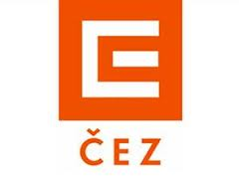
LGM in Moravia: An Archaeological approach
http://www.iabrno.cz/plevovce/
Petr Škrdla, Tereza Rychtaříková, Jaroslav Bartík, Yuri E. Demidenko & Ladislav Nejman
Supported by ČEZ, a. s.
© 2019 by Authors

Slide 2
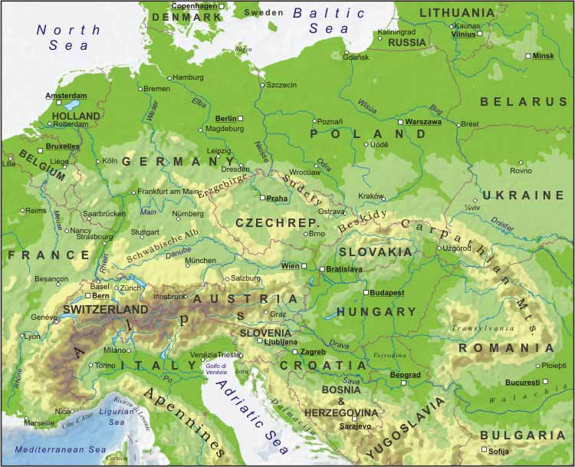
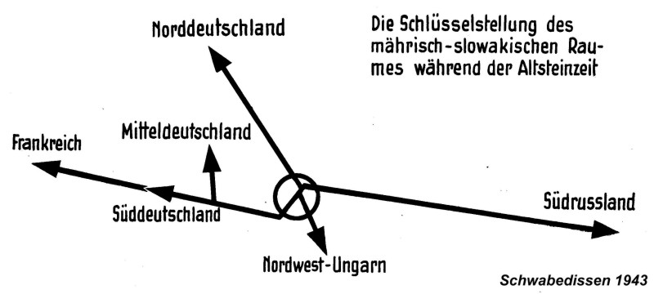
Moravia, its geographical position, and migration routes
There are only two stratified sites related to the LGM peak (23-19 ky calBP) in Moravia –
Stránská skála IV & Mohelno-Plevovce

Slide 3
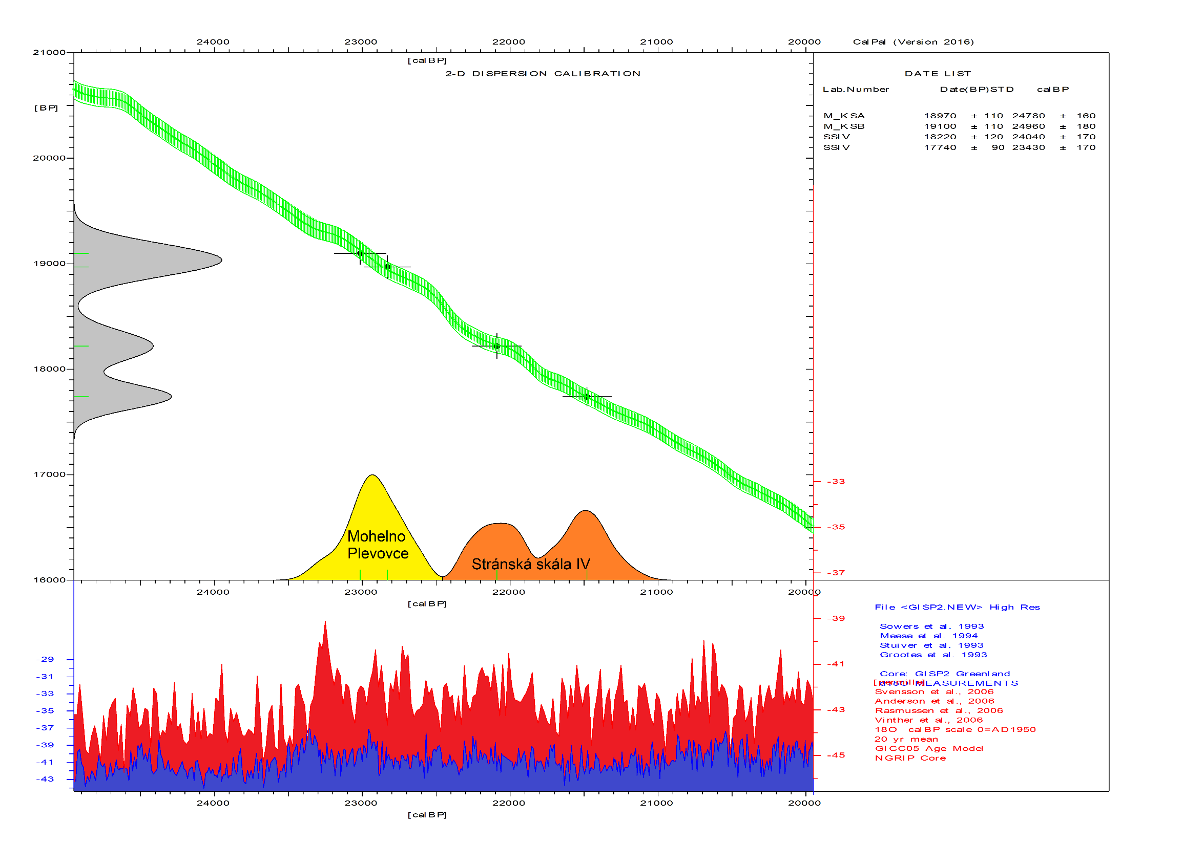
Dating: Stránská skála IV & Mohelno-Plevovce

Slide 4
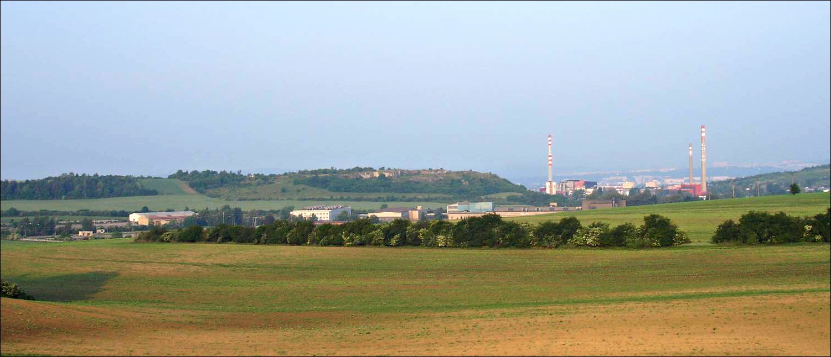
Stránská skála IV
Excavated by J. Svoboda during 1985-86;
Two horse bone accumulations with dispersed stone artifacts (a large number of blades, rocks often imported).
Interpreted as a horse-hunting site (Svoboda 1991).
Presence of dermestid pupation chambers suggest the horses were killed during Summer (D. West 1996).
Local geomorphology is similar to the North American buffalo jumps – a plain suddenly ending in a cliff.
(Svoboda 1991)

Slide 5
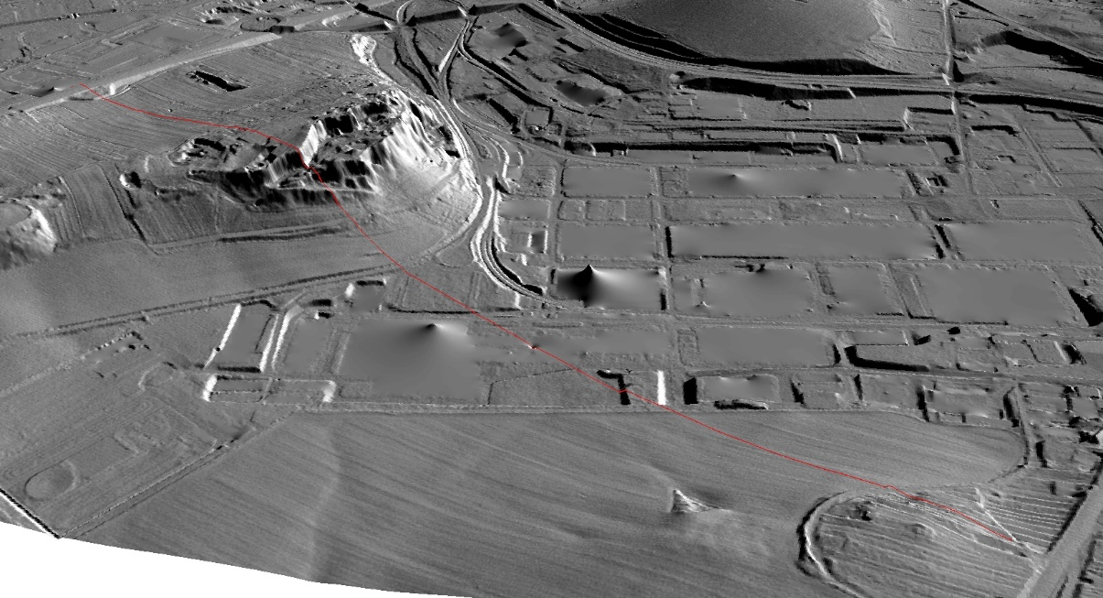
Stránská skála IV
Site

Slide 6
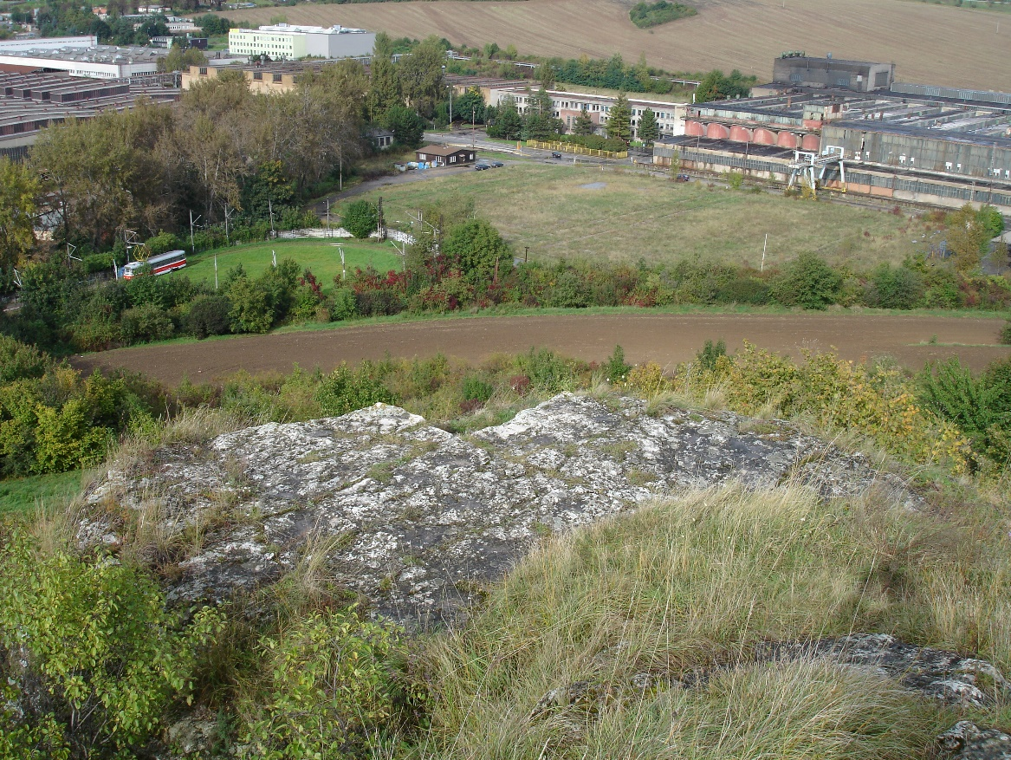
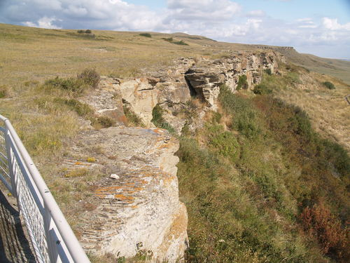
Stránská skála IV
Head-Smashed-In Buffalo Jump, Alberta, Canada
Stránská skála IV
The last step before a "jump"

Slide 7
Stránská skála IV
Dixie West‘s (1996) observations:
While heads are rare at Stránská skála IV, they are represented in all cultural levels at Grubgraben and in extremely high numbers in the Hungarian campsite Sagvar.
Segments of articulated tarsals and distal tibiae (encased within skin) recovered from Stránská skála IV suggest lower, nonmeaty limbs were frequently knocked away from meaty upper limb bones during the butchering process.
Horse scapulae were rarely recovered at Grubgraben and Sagvar, but were found in large numbers at Stránská skála IV.
Postcranial bones of horses at Stránská skála IV showed minimal evidence of breakage for marrow extraction.
Presence of dermestid pupation chambers suggests that the Stránská skála IV horses died during the summer allowing for a complete dermestid pupation cycle.
No evidence of carnivore gnawing was found on any postcranial bones from Stránská skála IV.
Fig. 10. Number of identified specimens of horse from Stránská slála IV. (Shaded areas represent absent bones; Cross hatched represent bones rarely found). According to West 1996.

Slide 8
Stránská skála IV
Raw material:
Imported: Radiolarite from White Carpathians and erratic flint from Northern Moravia / Southern Poland. Isolated implements from porcelanite (Eastern Bohemia?), rock crystal (Bohemian-Moravian Highland or Alps?), and obsidian (Tokaj Mts.)
Local: Mostly from local gravels (within a distance of dozens of kilometers), Stránská skála cherts from primary outcrops of were not utilized.
Technology:
While a high proportion of irregular blades is present, large blade cores are missing.
In contrast, while bladelet cores are frequent, bladelets (including backed forms) are almost missing (as a result of survey gap?).
Typology:
Common UP forms including endscrapers (both steeply retouched and flat), burins (including carinated forms) and retouched blades. One backed microblade. No Sagaidak-Muralovka-type microliths (excavation or survey gap? - or actually absent?).

Slide 9
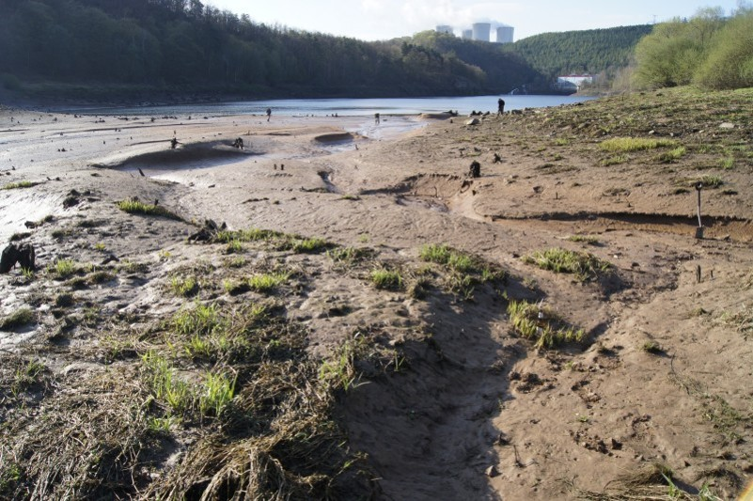
Mohelno-Plevovce
The Mohelno reservoir is a part of the Dalešice pumped-storage hydroelectric power plant. Since the end of the 1970s, the location has been continuously disturbed by erosion caused by fluctuating water levels. The water level rises and falls up to 8-12 m, often on a daily basis.
The site is excavated since 2013 by the authors. Two stone structures were excavated and two recently discovered stone structures will be excavated as soon as possible.
Analysis of osteological material from KSB indicates the presence of horse (Equus caballus) and reindeer (Rangifer tarandus).
The dominant charcoal species was birch (Betula sp., percentage proportion 60%), other common taxa was juniper (Juniperus sp., percentage proportion 30%) and only rare occurrences of willow (Salix sp., percentage proportion 1.7%) and Vacciniaceae (percentage proportion 8.3%) were recorded.

Slide 10
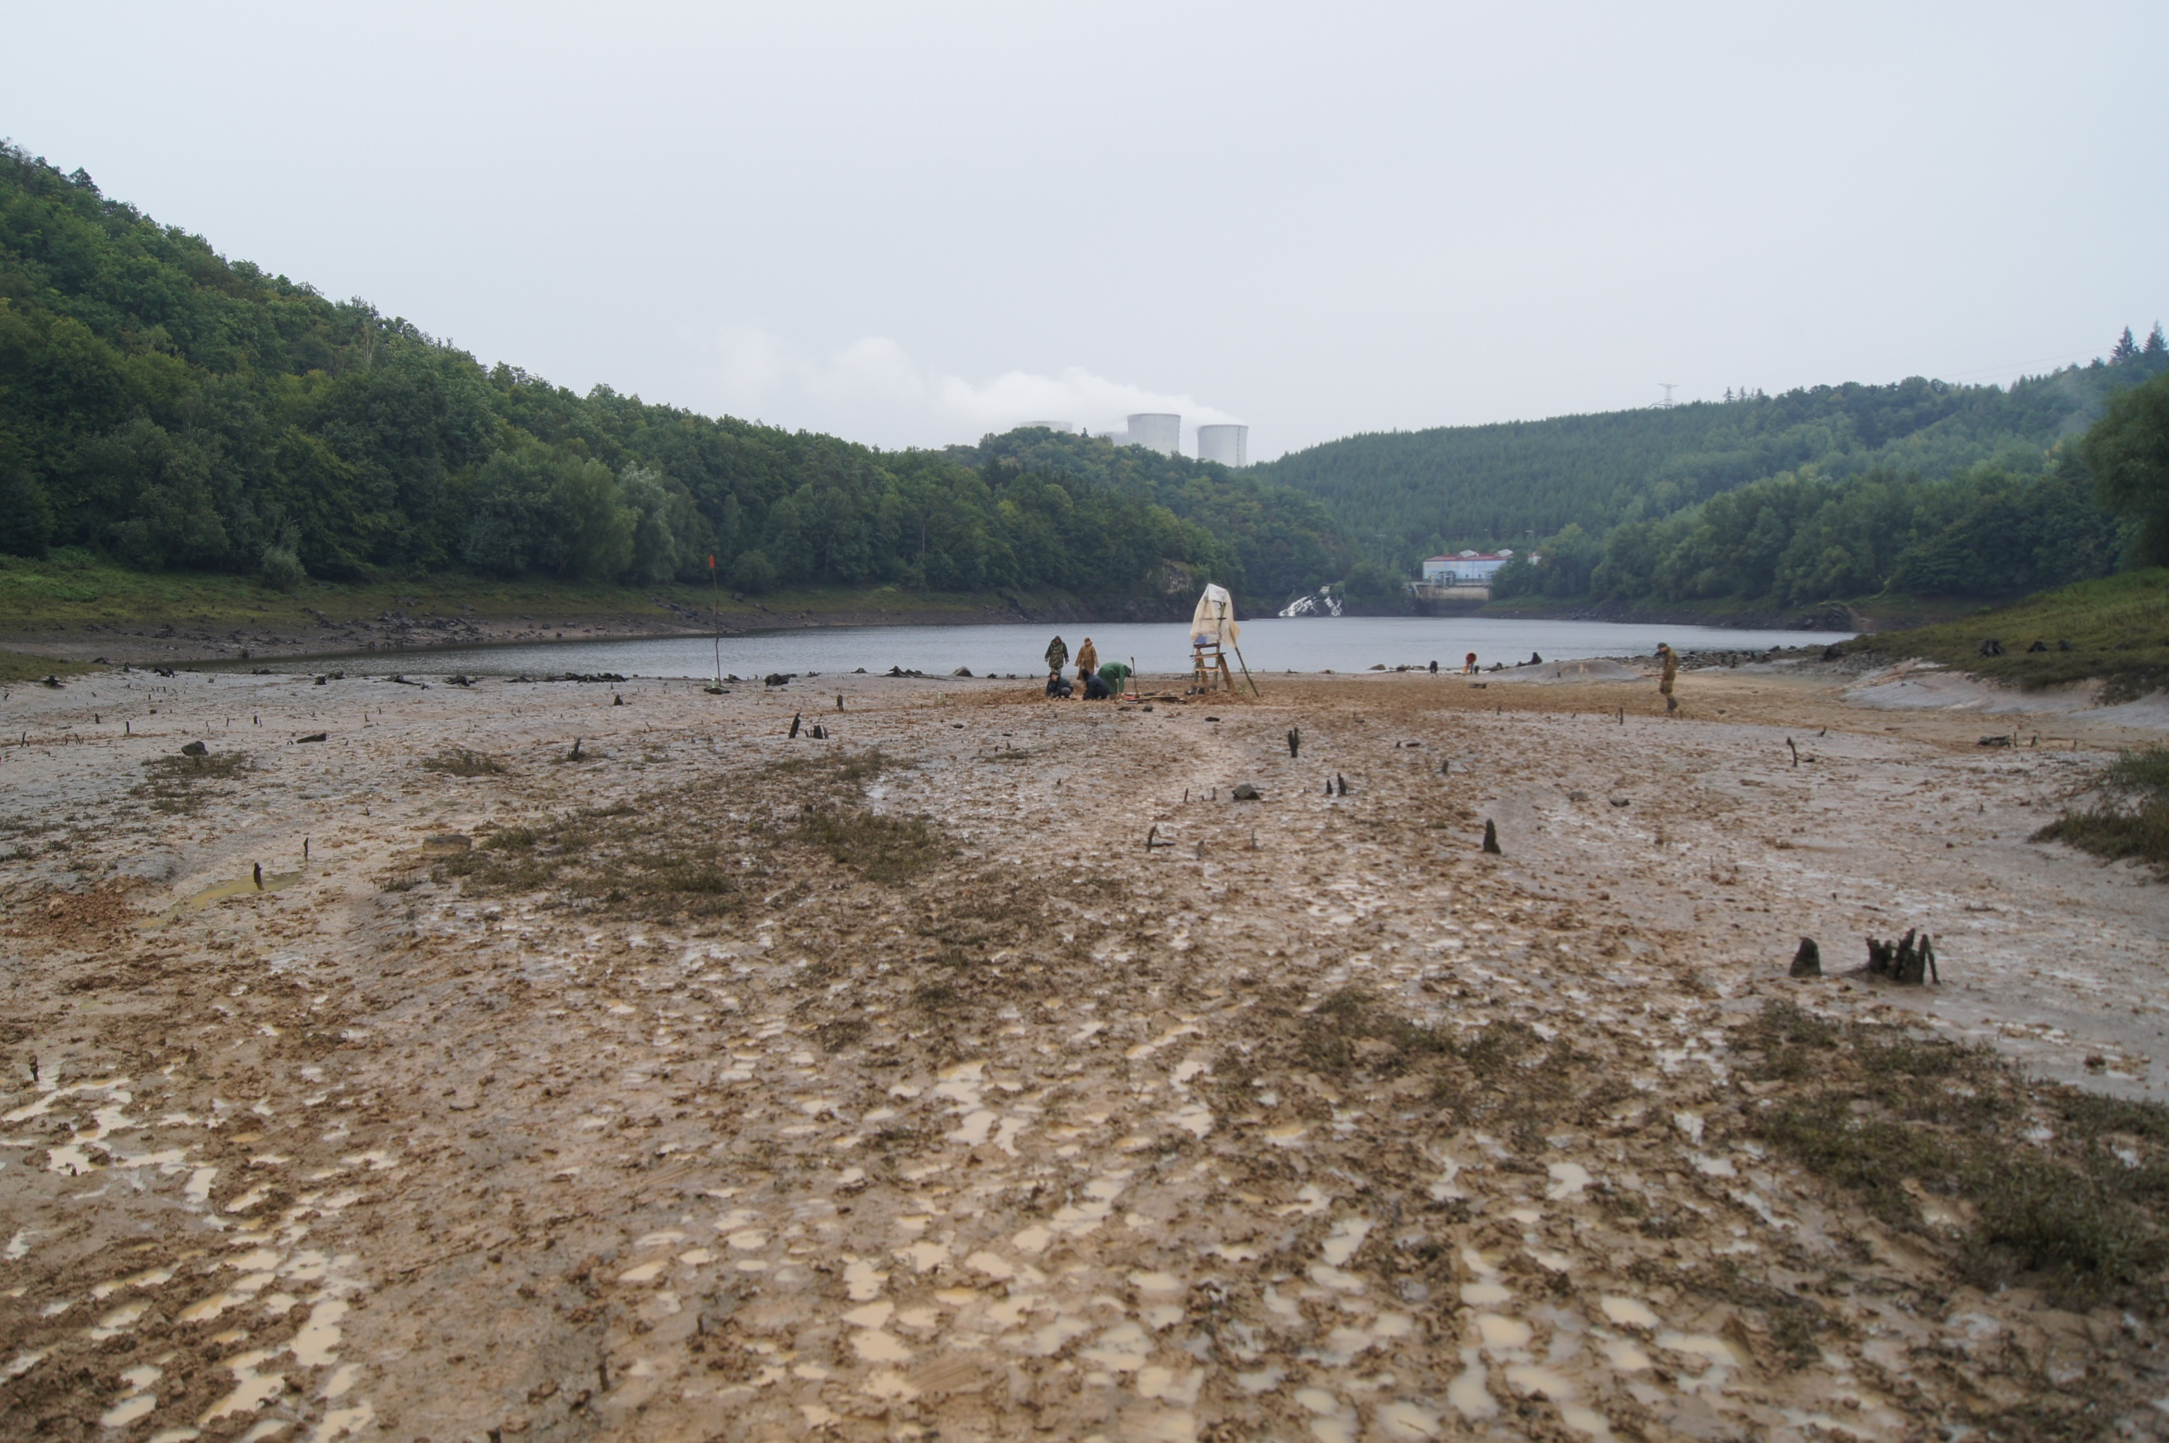
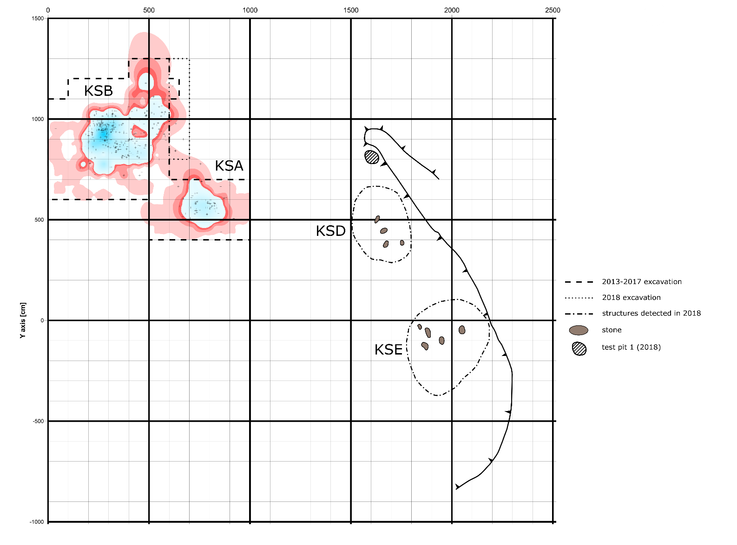
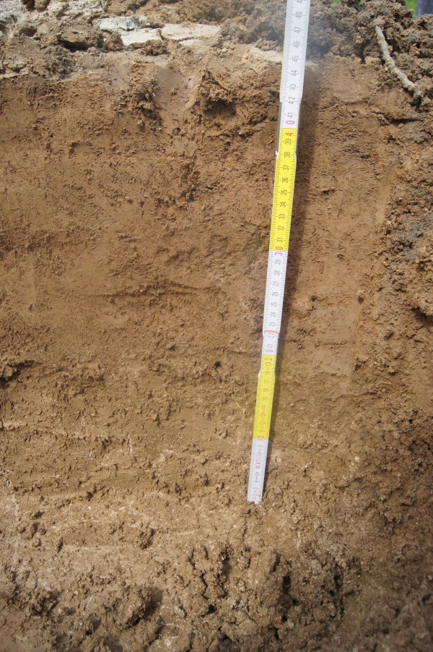
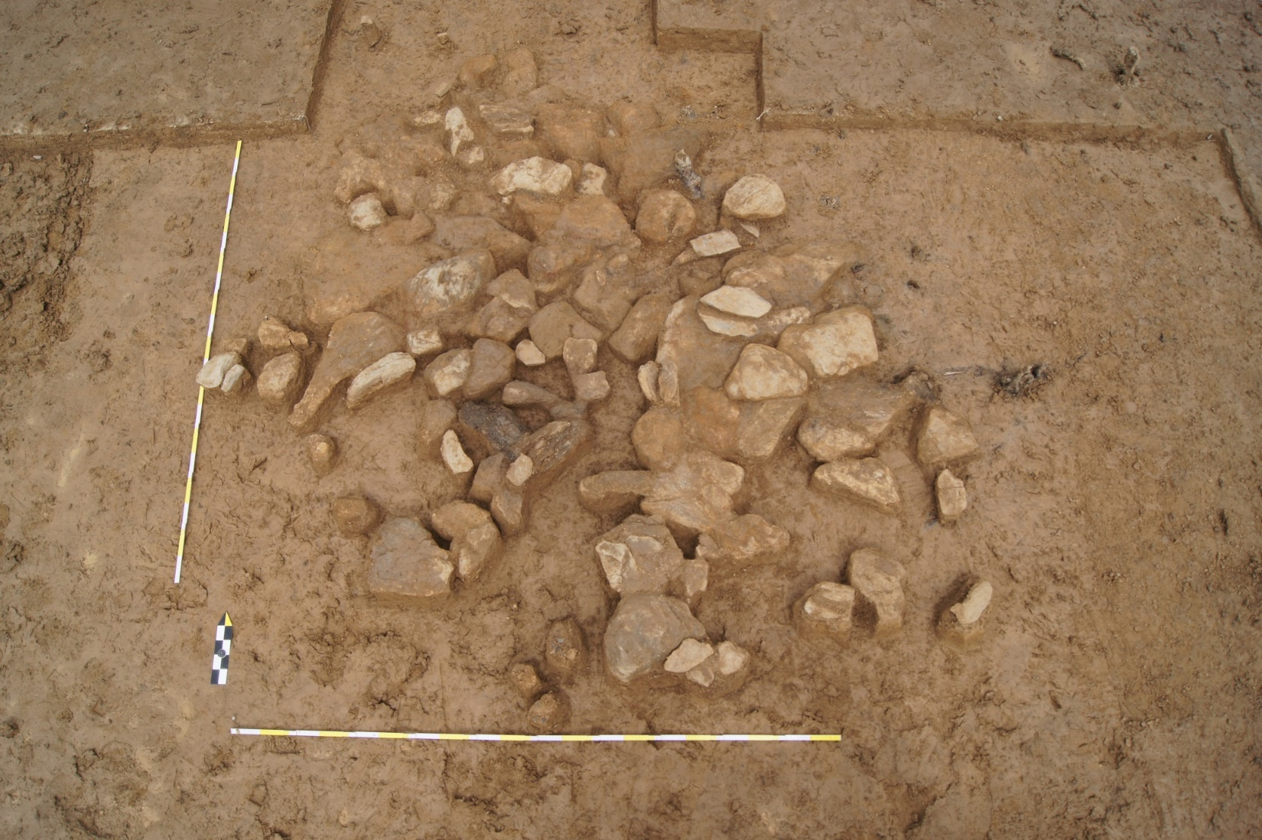
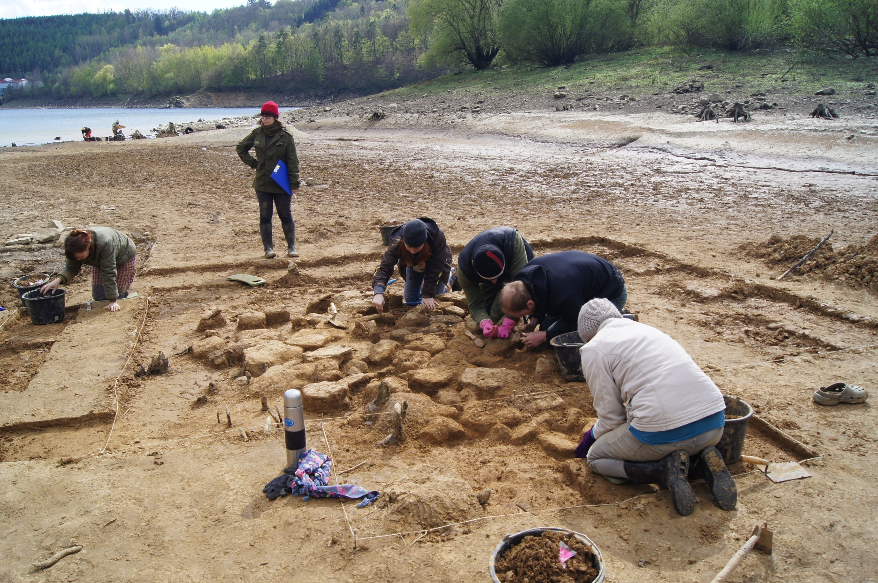
Stone structures

Slide 11
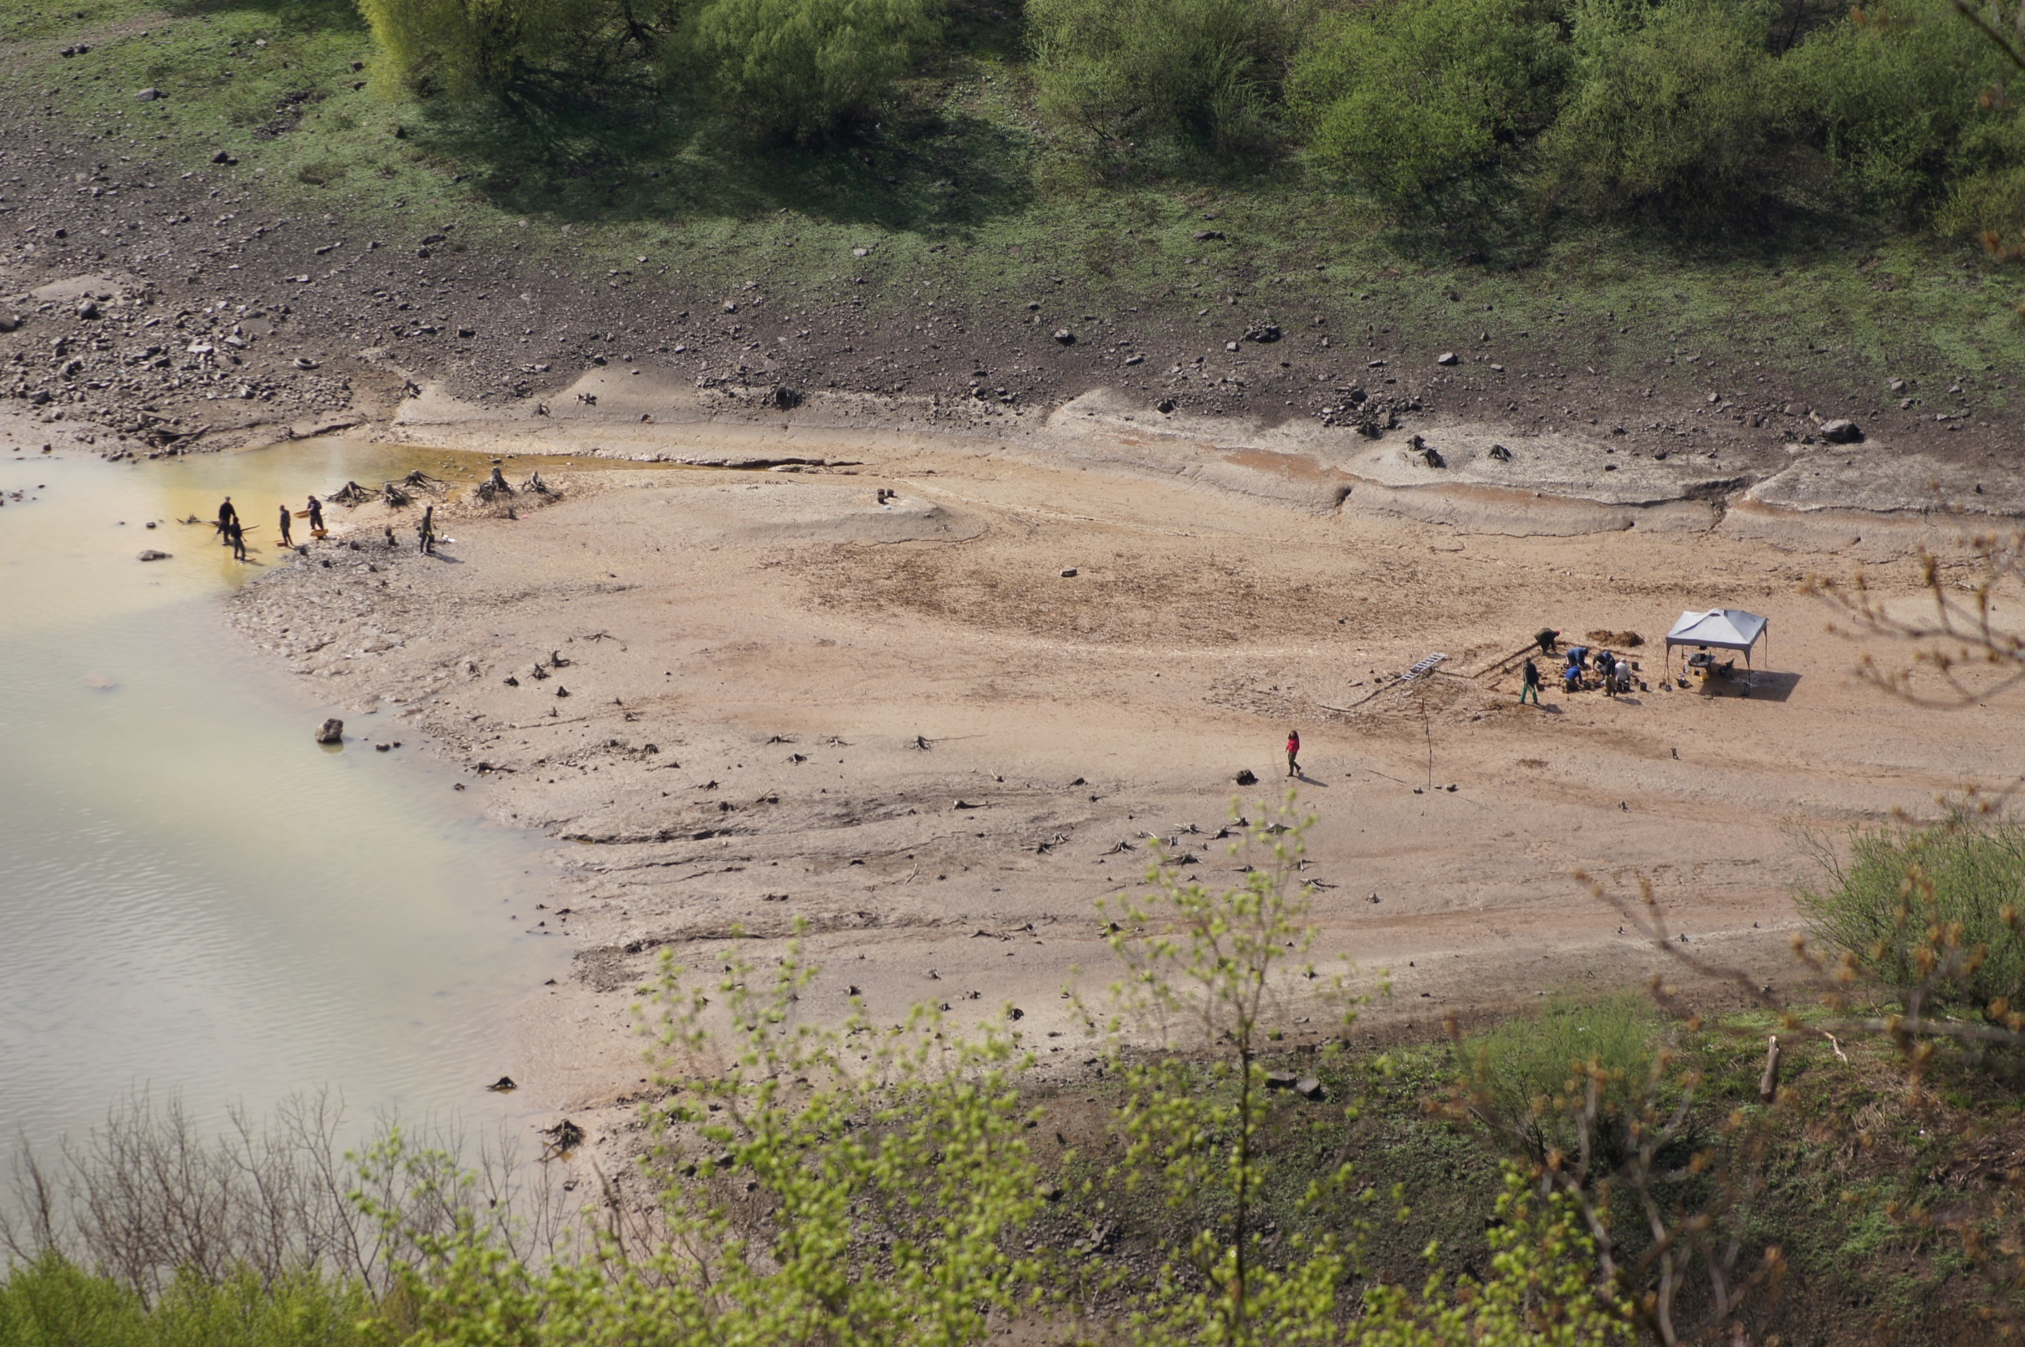
Mohelno

Slide 12
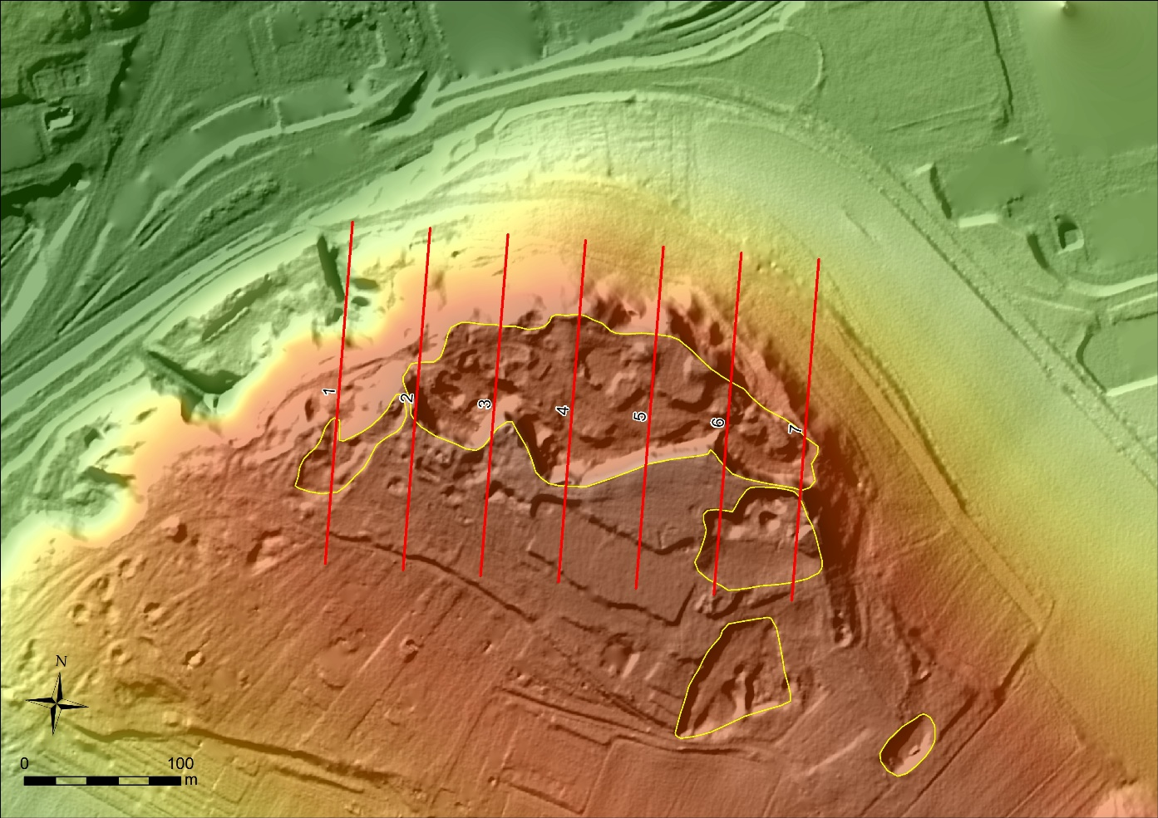
Comparison: Topography
Stránská skála IV: Concealed place, sheltered from the south – open to the north, not near a river;
Mohelno-Plevovce: Concealed place in a deep river valley, open to the south - sheltered from the north, east and slightly west, "a microclimatic oasis"
= > Completely different topographic locations
Mohelno-Plevovce
Stránská skála
IV

Slide 13
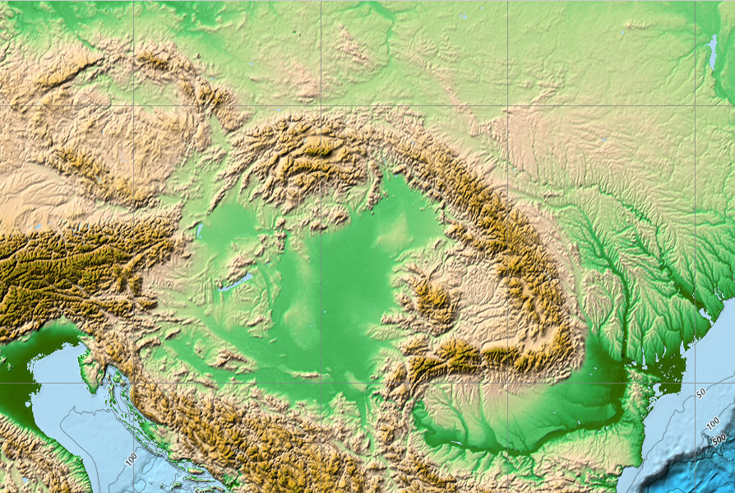
Imported raw materials (Brno as a reference point, in direct lines)
Erratic silicite
(~100km)
Rock Crystal
(~40km)
Radiolarite (~100km)
Obsidian (~380km)
Szentgál Radiolarite (~260km)

Slide 14
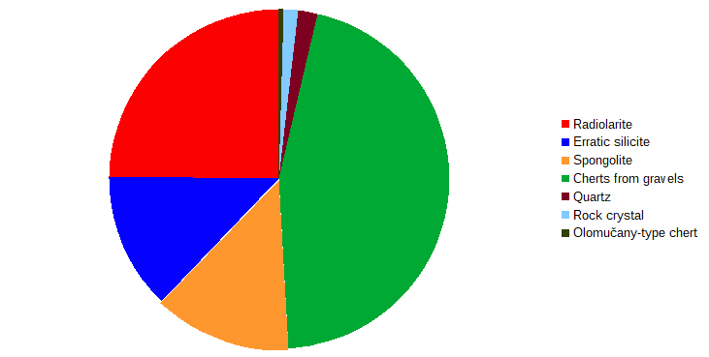
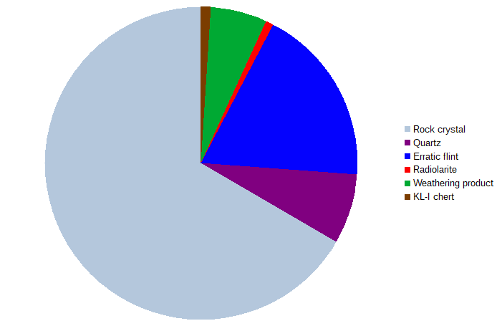
Comparison: Raw material supply
Stránská skála IV
Stránská skála IV: Imported and local rocks (from nearby gravels) are almost in equal proportions.
Mohelno-Plevovce: In total, local rocks significantly prevail over imported.
= > Similar, however, more rock varieties (although represented by isolated items) in Stránská skála assemblage and Szentgál-type radiolarite in Mohelno assemblage.
Local rocks: 60.4%
Mohelno-Plevovce
Local rocks: 80.7%

Slide 15
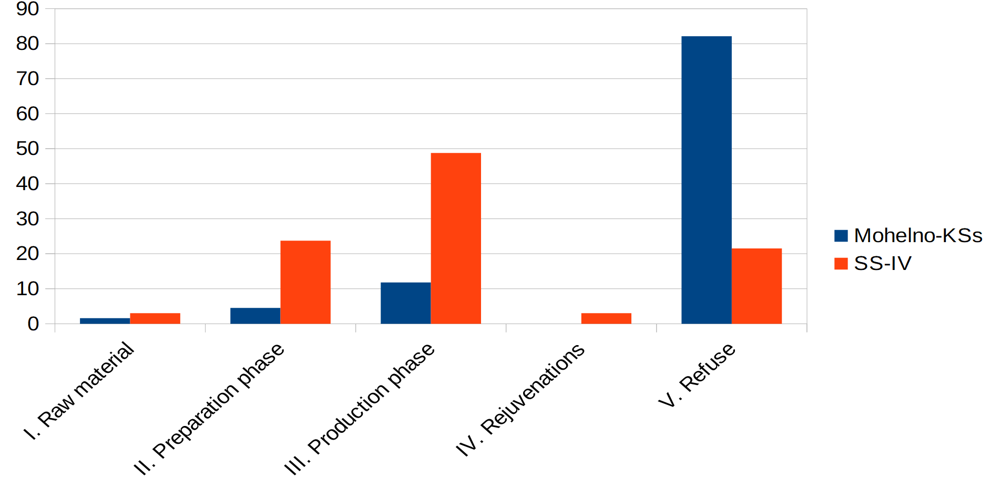
Comparison: Technology
Stránská skála IV: blade technology, however, blade cores are missing, bladelet cores (bladelets are missing – excavation gap)
Mohelno-Plevovce: flakes, iregular cores, end scrapers and splintered tools served as cores for Sagaidak-Muralovka type microliths production.
= > Completely different

Slide 16
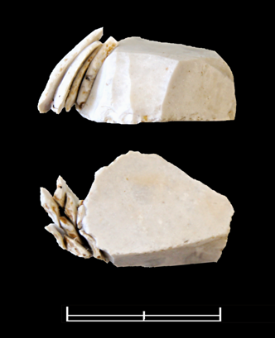
Comparison: Typology
Stránská skála IV: End scrapers (including atypical carinated forms), burins (including carinated forms), backed microblades
Mohelno-Plevovce: End scrapers (including atypical carinated forms), splintered pieces / bipolar anvil cores, simple burins, Sagaidak-Muralovka-type microliths
= > Completely different

Slide 17
Concluding remarks
Utilisation of local rocks increases in contrast to the preceeding Gravettian.
Do the observed differences reflect different site functions?
Or do they reflect a heterogeneous group of industries during LGM?

